Slide 1
Lecture2
Structures

Slide 2
Main Points
User Defined Structure Types
Direct/indirect component selection operator
Passing structures as input/output parameters
Array of Structures
C Exercises

Slide 3
Structures: Overview
A new Derived Data_Type/Data_Structure
Data_Types you have seen so far:
Integer
Double, Float
Char, strings (Arrays) .
Structures : Used a lot! (Stacks, Linked Lists,Trees, ..)
A data type for a record composed of multiple components
Why a need for such a new Data_Type?

Slide 4
Structures: Continue..
Main point: A Need to aggregate data of
different types
Arrays: gather Data elements of a same Data_Type.
Records: gather Data elements of different type.
In C/C++ a record is called a structure.
A typical use of structures is representing DataBases records

Slide 5
Structures: How to use them?
Typedef struct {
Data_type1 member_1;
Data_type1 member_2;
.
.
.
Data_type1 member_n;
} struct_name;
struct_name Var1, Var2;
Var1 & Var2 are two variables of type struct_Name
Members  elements of a structure

Slide 6
Structures: an example
Typedef struct{
char course_code[7];
int n_crd;
char instructor_name[20];
int n_students;
}courses;
courses course1,course2;
You can use courses as a regular data type

Slide 7
typedef
Important: the typedef statement itself allocates no memory.
A variable declaration is required to allocate storage space for structured data object.
The memory allocated for course1 consists of 4 distinct values

Slide 8
Manipulating Individual Components of a Structured Data Object
We can reference an element of a structure using the direct component selection operator: a period
The period should be preceded by the name of a structure type variable and then followed by the name of the component
Refer to the next slide

Slide 9
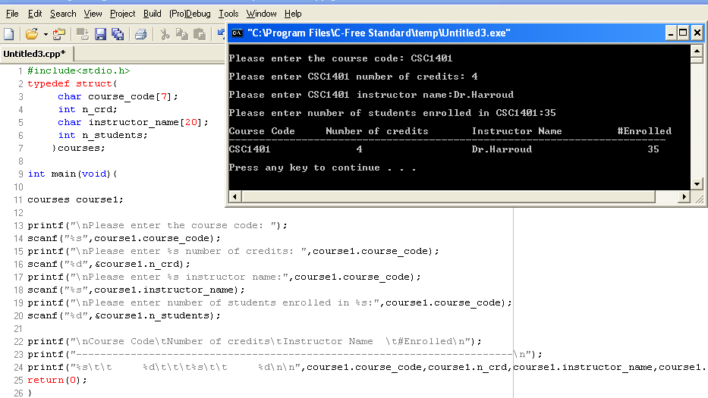
Example

Slide 10
Structures as input/output parameters
When a structured variable is passed as input argument to a function, all of its component values are copied into the components of the function’s corresponding formal parameter.
When such a variable is used as an output parameter, the address of operator must be applied same way that would pass an output of type char, int, and double
As with other data types, structures can be passed by value or by reference.

Slide 11
Structures: Passing by value/reference
By value:
void display_course(courses c1){
printf("%s %d %s %d\n", c1.course_code,c1.n_crd,c1.instructor_name,c1.n_students);
}
By Reference
void fill_course(courses *c1){
strcpy((*c1).course_code,”Phy1401”);
(*c1).n_crd=4;
strcpy((*c1).instructor_name,”Dr.Darhmaoui”);
(*c1).n_students=32;
}
This code can be written using the indirect component selection operator (see the next slide)

Slide 12
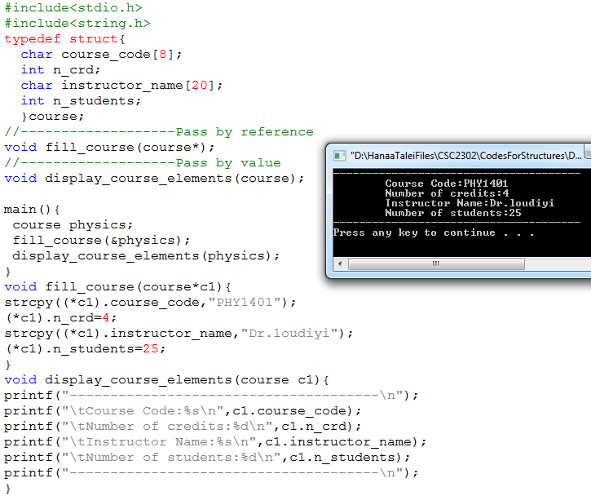
Direct Vs Indirect component selection operator
This piece of code can be changed to indirect component selection operator: refer to the next slide

Slide 13
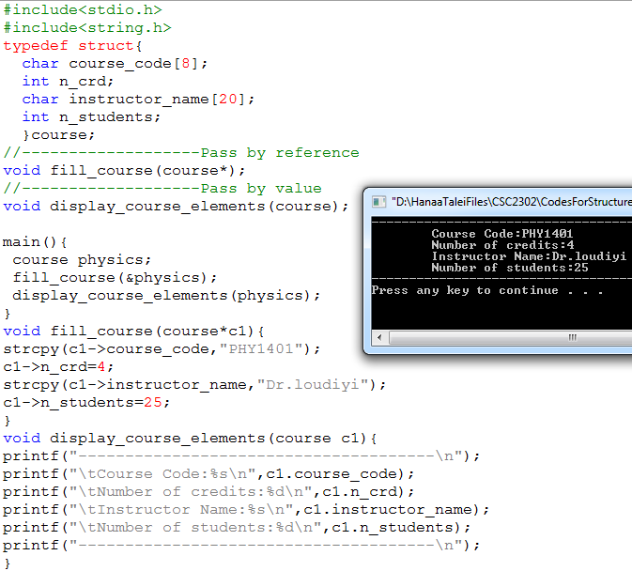
Indirect component selection operator

Slide 14
Exercise
Write a C program that swaps the content of two courses. Use the following functions
Fill_courses()
Display_courses()
Swap_courses()

Slide 15
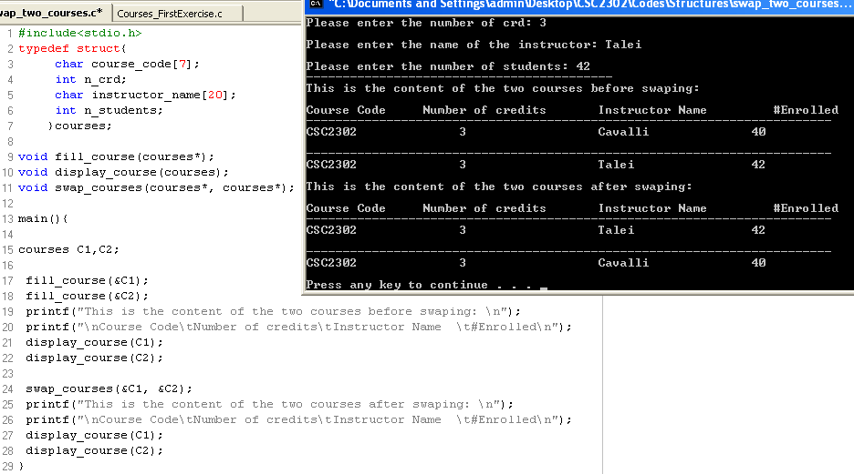
Solution (Part1)

Slide 16
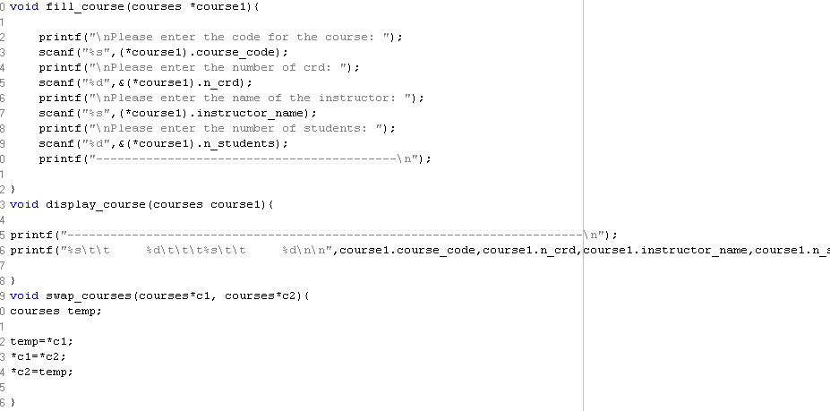
Solution (Part2)

Slide 17
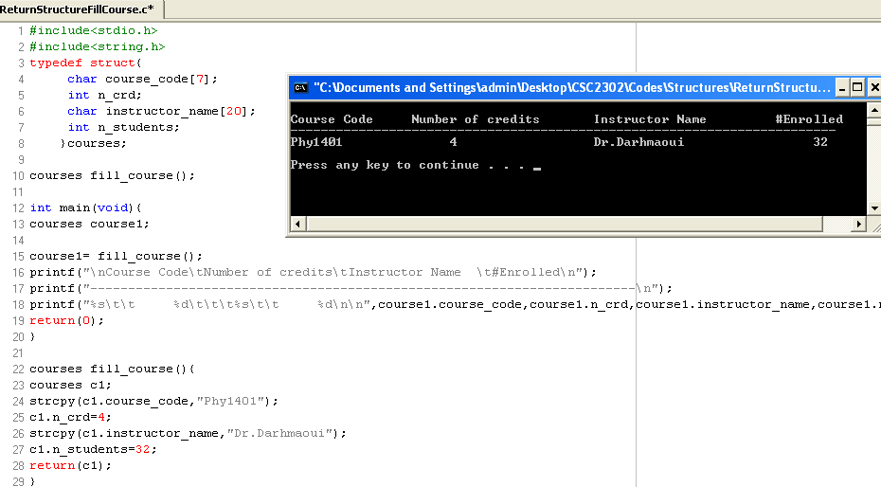
Structures as return values
As with other data types, a structure can be returned by a function.
Example:

Slide 18
Hierarchical structures
Structures can be members of other structures
Example:
typedef struct{
char s_name[20];
int s_id;
address s_address;
}student_info;
typedef struct{
char city[20];
char street_name[30];
char residence_name[20]
int appart_num;
}address;

Slide 19
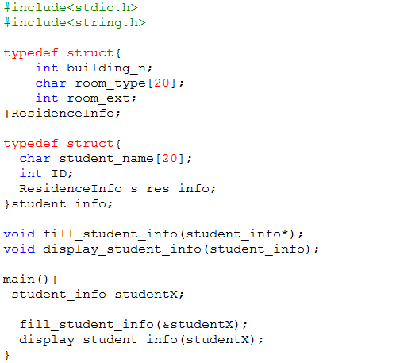
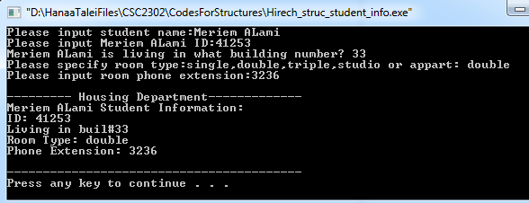
Hierarchical structures(Cont..)

Slide 20
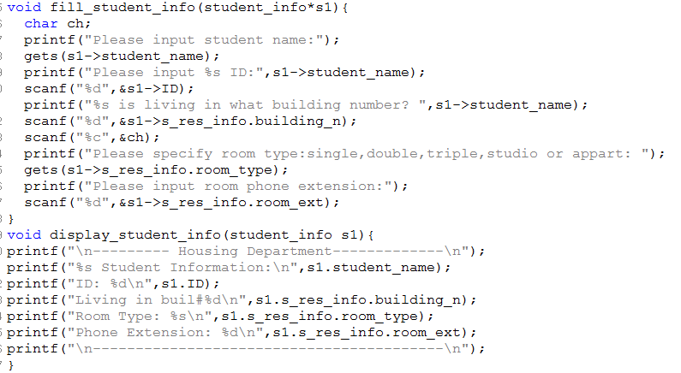
Hierarchical structures (Cont..)

Slide 21
Exercise
A straight line is an object connecting two points. Therefore, a line can be represented by a hierarchical structure having two structures of type point
Write a function that accepts two parameters of type point and returns a structure of type line representing that line.
Write another function that accepts a structure of type line and returns an integer (1, 2, 3), where 1 means vertical, 2 means horizontal, and 3 means oblique.

Slide 22
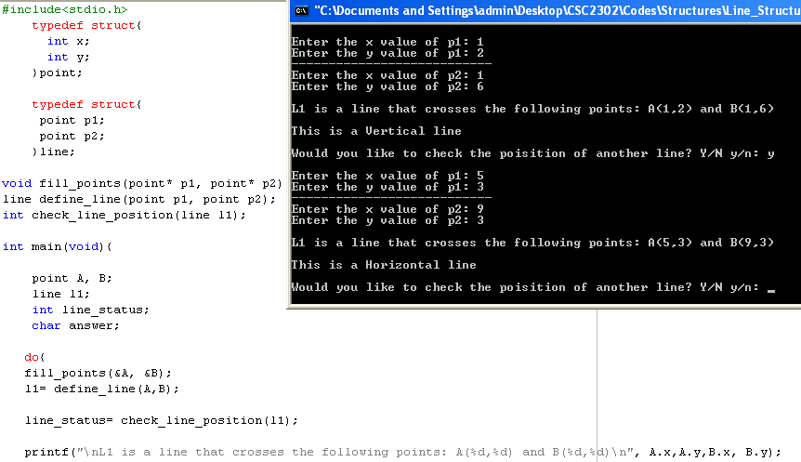
Illustration(1)

Slide 23
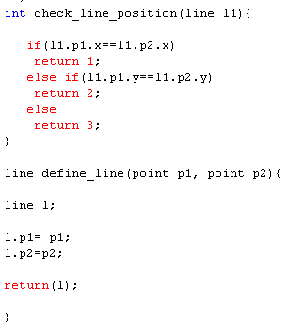
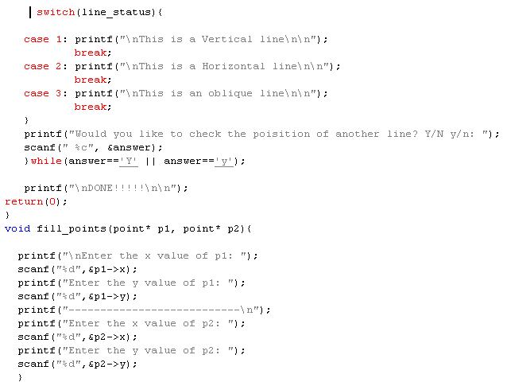
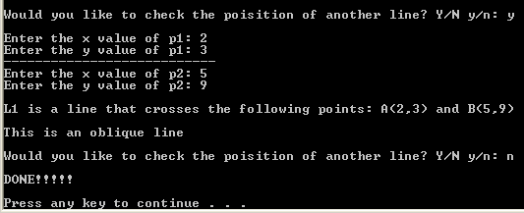
Illustration(2)

Slide 24
Array of Structures
Refer to the code I posted last week
We will change the code so that we use only one array to hold students information: ID, Grade and Name.
Refer to the next slides to compare the two versions of code

Slide 25
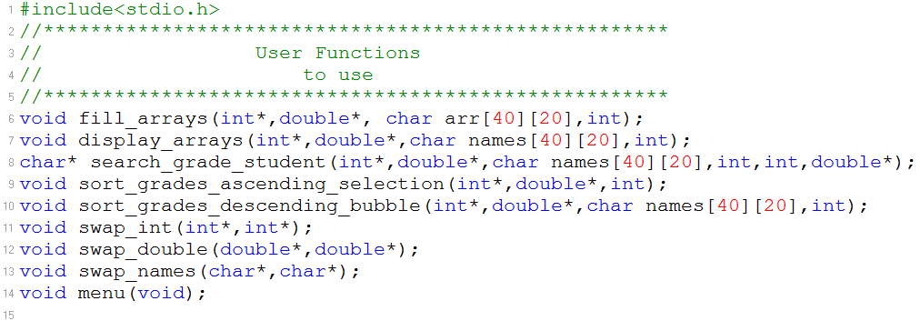
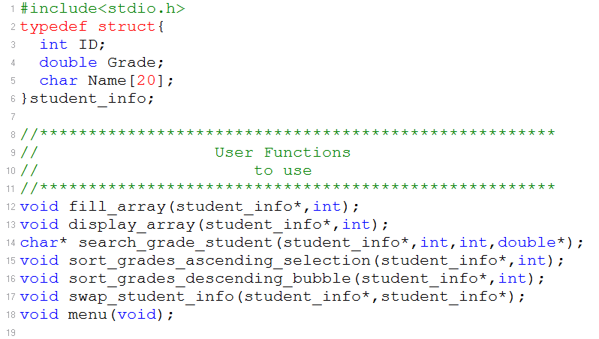
Functions to use

Slide 26
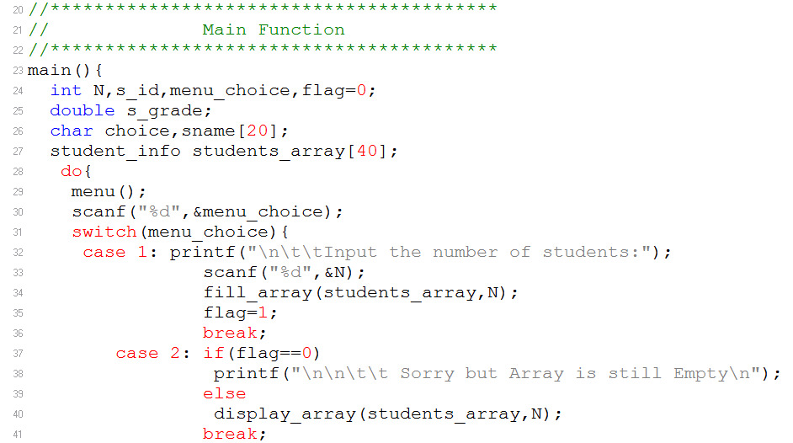
Main() function

Slide 27
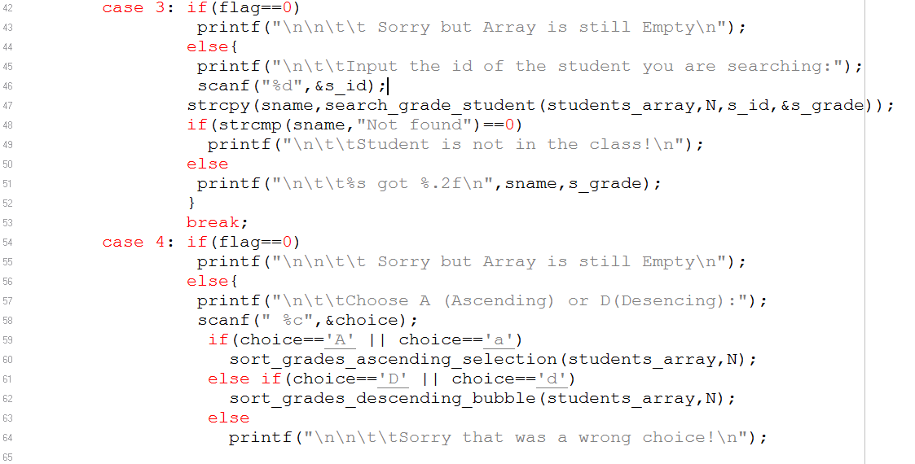
Cont..

Slide 28
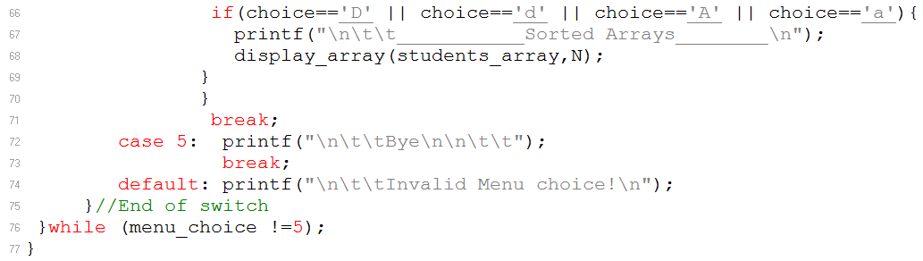
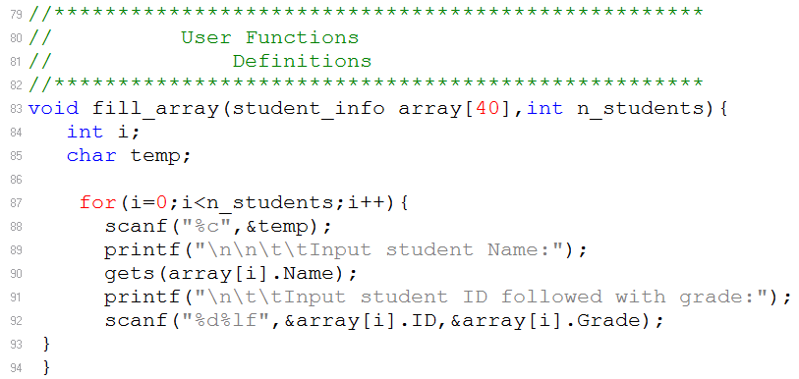
End of the main() function+…

Slide 29
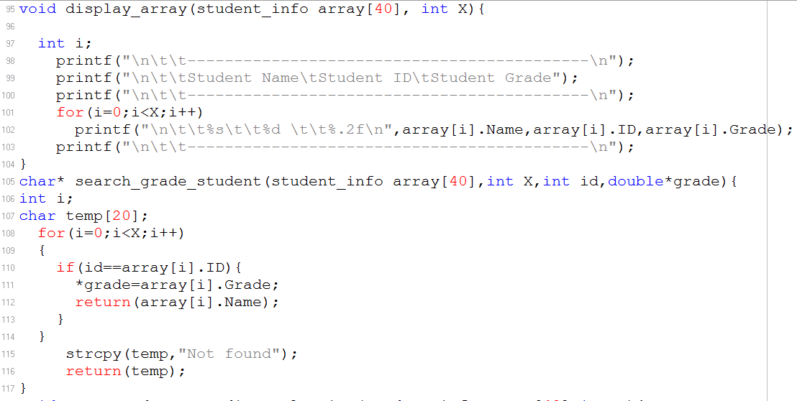
More about functions..

Slide 30
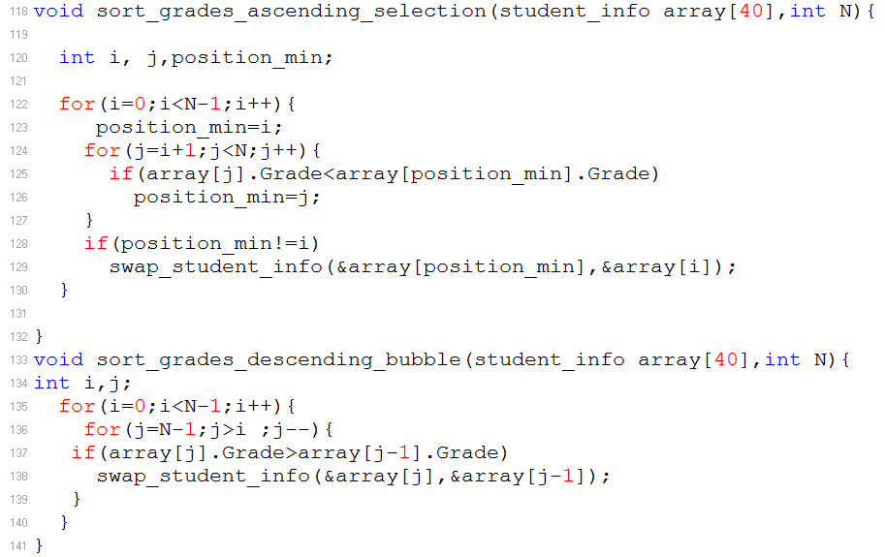
More about functions..

Slide 31
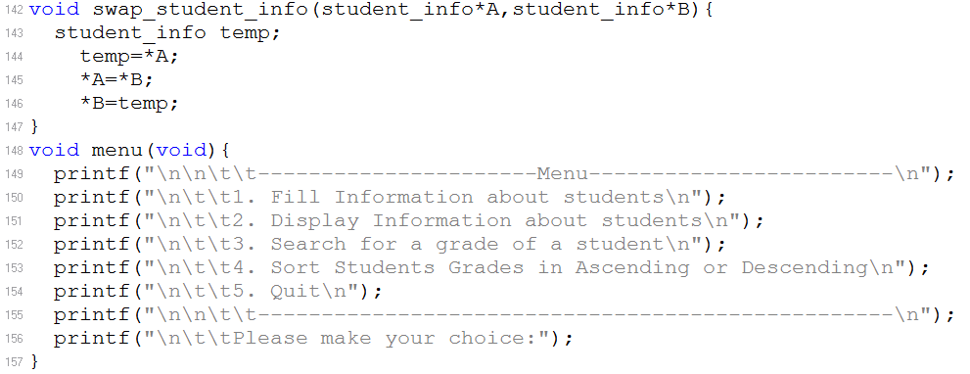
More about functions..

Slide 32
Programming project from your book: Exercise 5 page 642
In Class Discussion
IP addresses
Same Locality
Your C program should display a list of messages identifying each pair of computers from the same locality.
Follow the messages by a display of the full list of addresses and names.

Slide 33
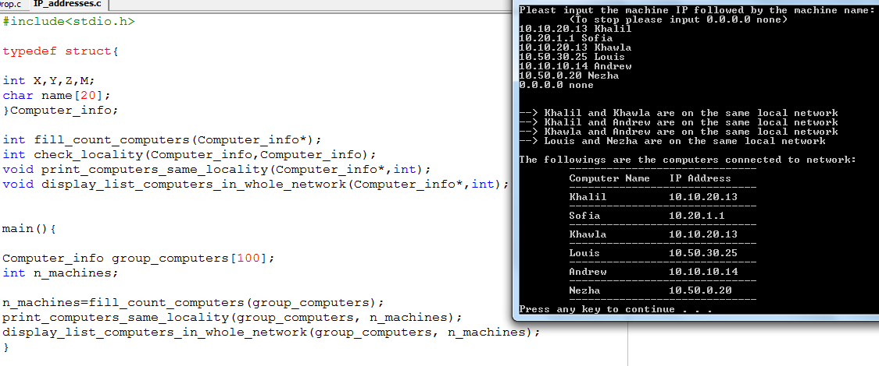
Solution

Slide 34
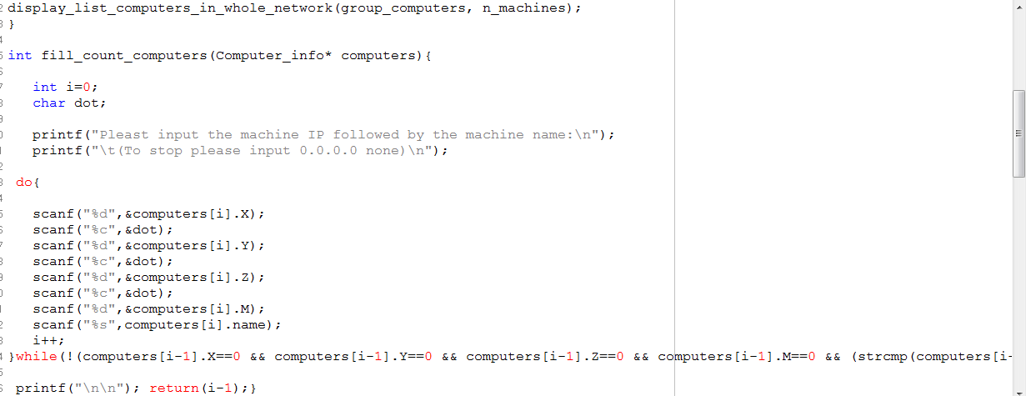

Slide 35
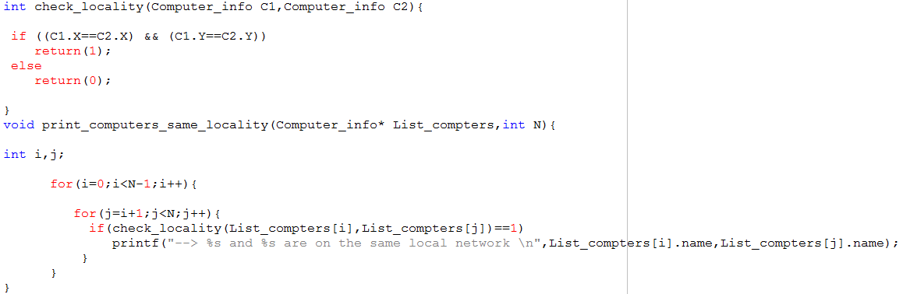
Solution (Cont)

Slide 36
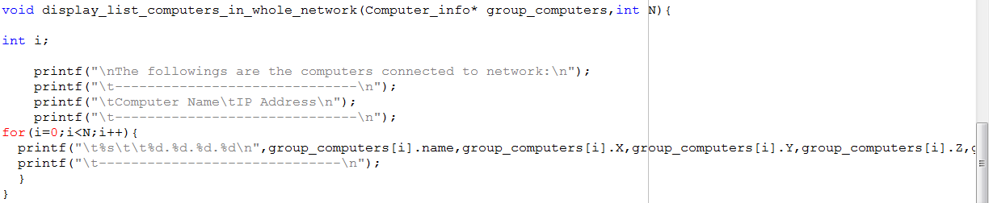
Solution (Cont)

